Slide 1
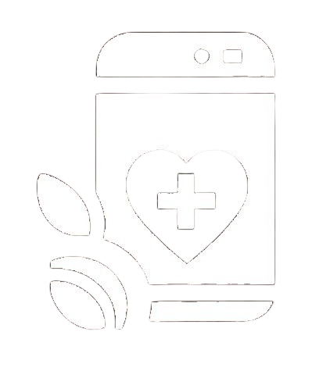


uSpark
AI Medical Assistor
Sprint 0 Presentation
Team 1 – Rush Hour
CS691
February 2025

Slide 2

AGENDA
Team :
Project Overview :
Technologies
Schedule and Agreement
Retrospective
Names and Introduction
Roles and Responsibilities
Brief Description of the algorithms and testing tools used in the Project
Reached Goals?
What went well
Corrections needed
Updating Backlogs
Problem Statement
Project Description
Personas
Product Idea
Project Schedule and Team Working Agreement

Slide 3
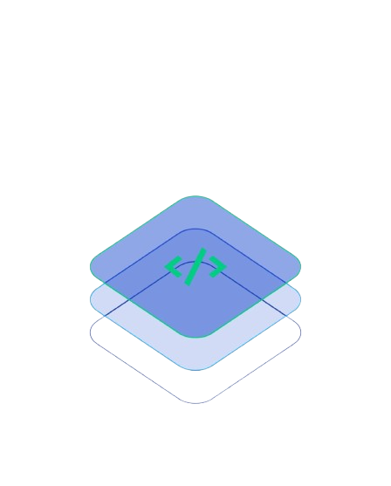
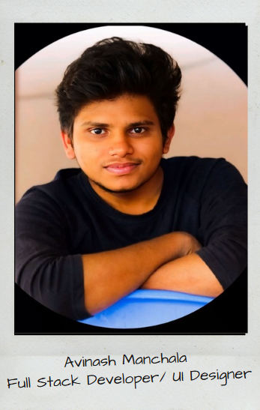
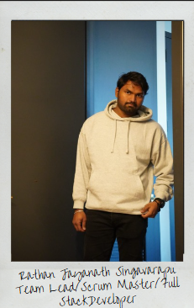
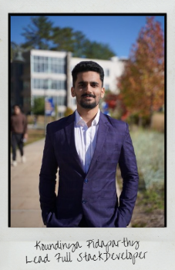
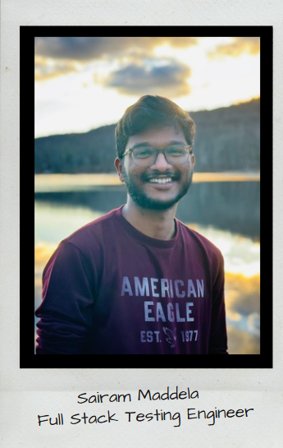
FULL STACK TEAM

Slide 4

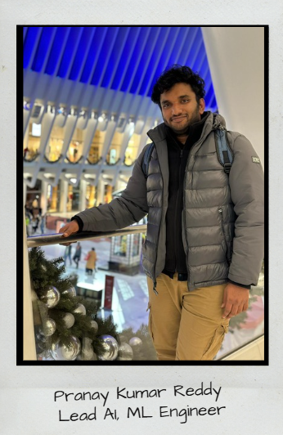
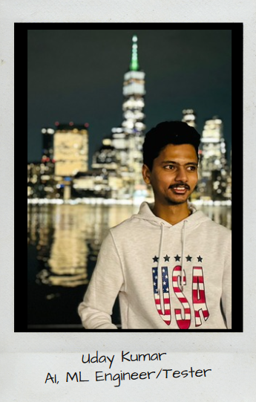
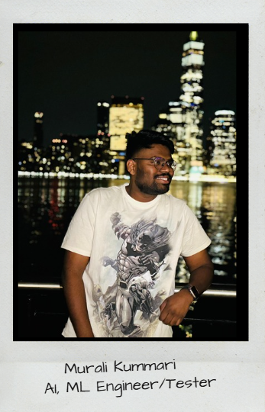
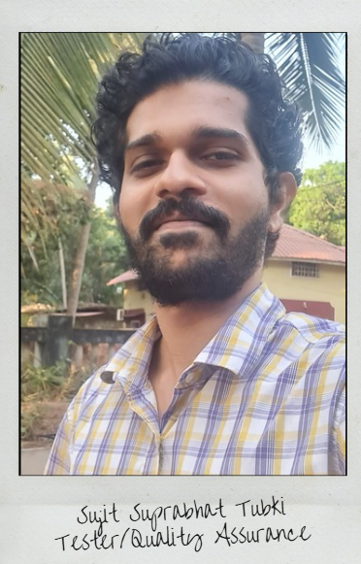
ML AI TEAM

Slide 5
PROBLEM STATEMENT
Continuous Medical Assistance is one of a non-negotiable requirement these days and it can't be ignored. It is tedious to manage and store data related to a diagnosis of a patient for hospitals and for the patient as well. A simplified way of managing health care is needed, which can be achieved through AI chatbot and smart data storage system and like wise professionals in the medical sector can use a trained ML based algorithm service to reduce manual effort in the patient diagnosis.
This creates a hassle-free environment for both patient and doctors.

Slide 6
PROJECT DESCRIPTION
A robust approach to ease the process of health care and management with just one click!
➔“uSpark” is an Intelligent full stack application incorporated with machine learning that is an ultimate go-to point for the users/patients for all their healthcare related issues. uSpark allows users to schedule appointments in a hassle-free manner.
➔ These appointments can be virtual or in-person using “Uheal” a smart chatbot in the application that diagnoses the patient condition with the help of few questions. uSpark stores all the assessment details of the patient for further usage.
➔ Doctors can use uSpark as their personal virtual assistant that helps them in their work for managing appointments and patients records. It provides doctors with “Useg” a well-trained ML algorithm that precisely processes bio-medical images that produces an output

Slide 7

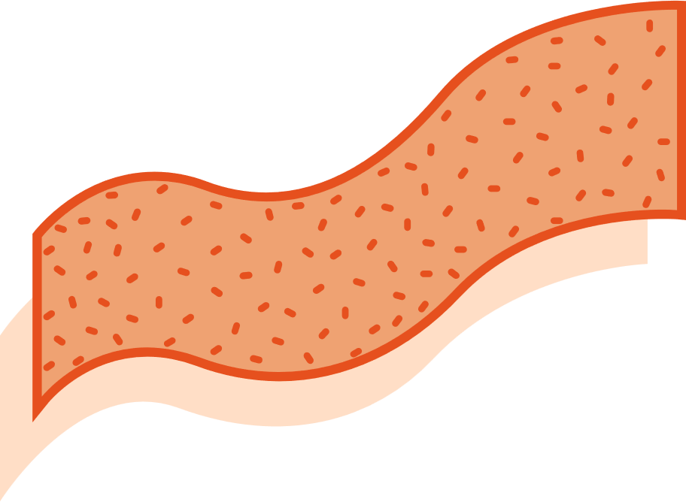




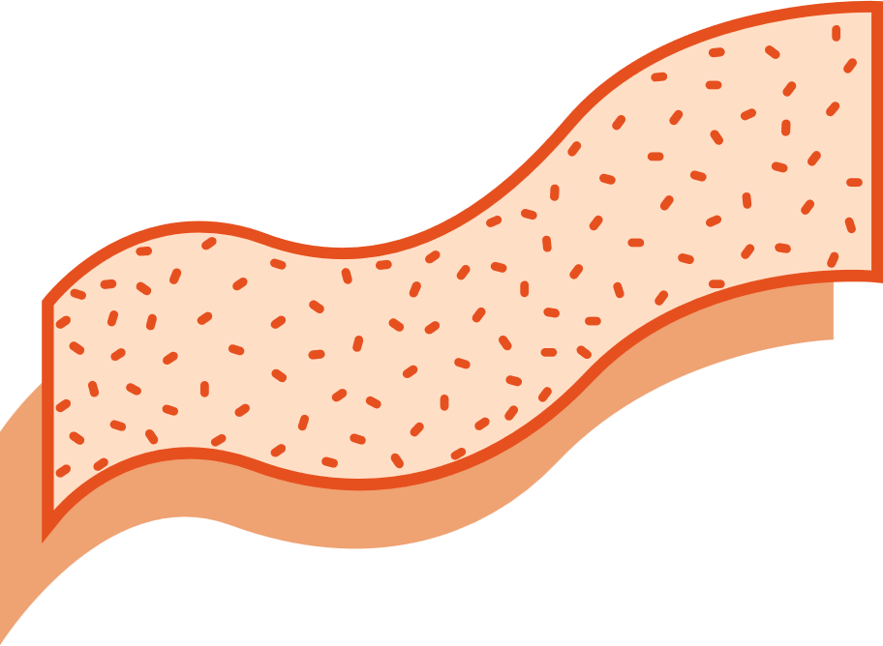



uSpark Application
FEATURE2
FEATURE 1
HOSPITAL RECOMMENDATIONS
Users can now see recommendations of hospitals that might be suitable for their issue. These recommendations on their assessment done via a series of questions asked by our chatbot “Uheal”
Distance from Hospital, working hours can be seen.
BOOK APPOINTMENTS!!
uSpark allows users to make appointments which can be in-person or virtual based on their availability and doctor’s availability , in contrast to the traditional way of making appointments
FEATURE 4
ONE CARD
FEATURE 3
uHeal stores the details of the health issue of the patient which is obtained from the conducted assessment, all the assessment details are saved on ONE CARD along with the date of assessment. One card involves patient’s assessment details, insurance details, personal details and a QR code that is used to share the ONE CARD, this completely eliminates the need for physical documents to store information.
CHATBOT – Uheal
uHeal conducts assessment for the patients with the help of series of questions and also gives few preventive measures and also it makes appointments for the user by giving recommendations about hospitals, in contrast to traditional method of searching hospitals
FEATURE 5: Useg
Useg is an ML algorithm that is used by doctors as a part of their diagnosis.
This makes their work easier and helps them to narrow down the issue in a much quicker way

Slide 8
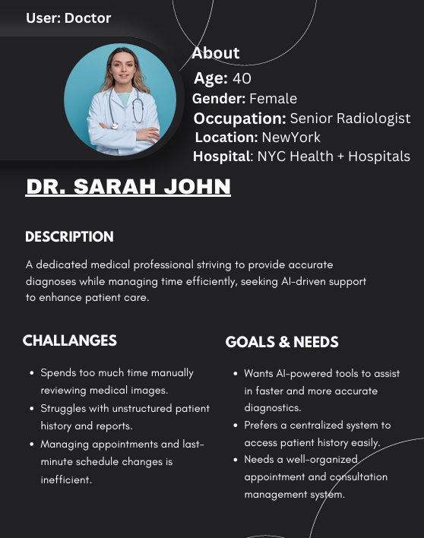
Persona 1
1

Slide 9
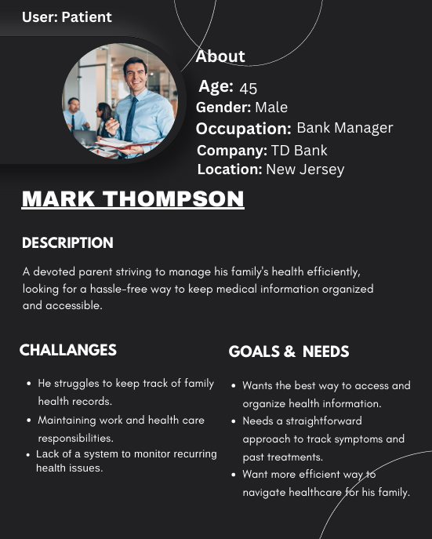
Persona 2
1

Slide 10
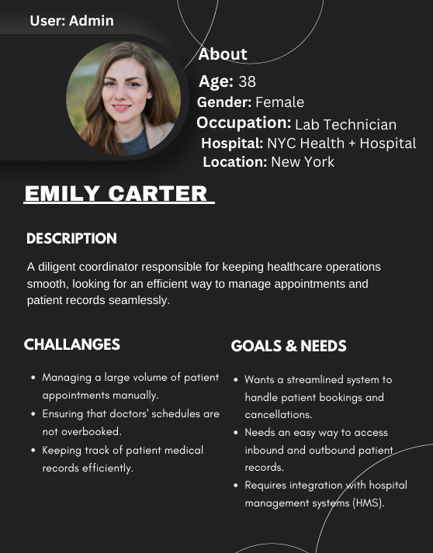
Persona 3
1

Slide 11
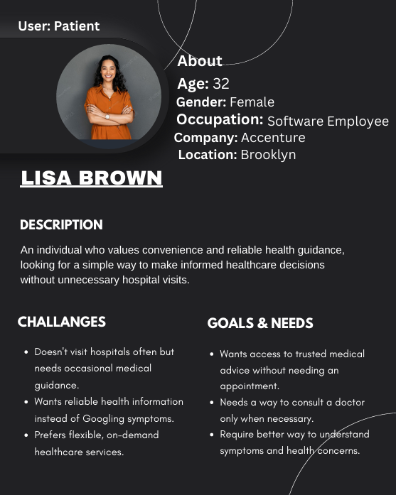
Persona 4
1

Slide 12








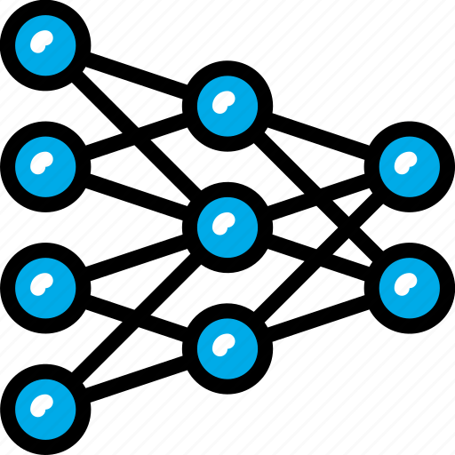
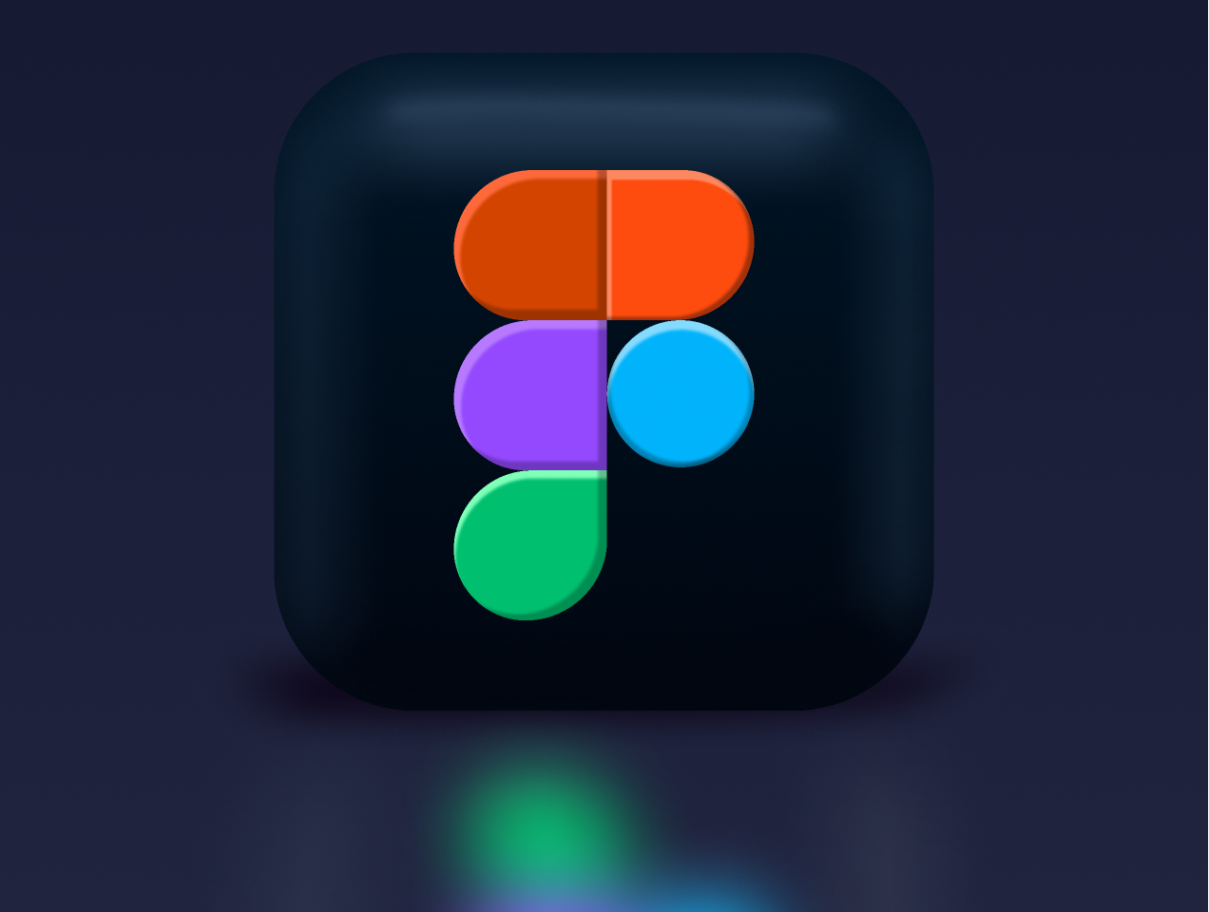







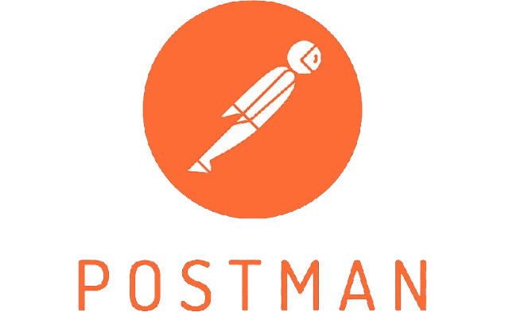

Technologies and Tools
Mongo DB
Amazon S3
Jira
Docker
Node JS
React
Python
CNN
Figma
MERN Stack
VS code
Redux
Axios
Tailwind CSS
Pytorch
TensorFlow
Flask
GitHub
Postman
Full Stack /MI AL Programming Languages
Libraries, Algorithms and Frameworks, Database
Tools

Slide 13
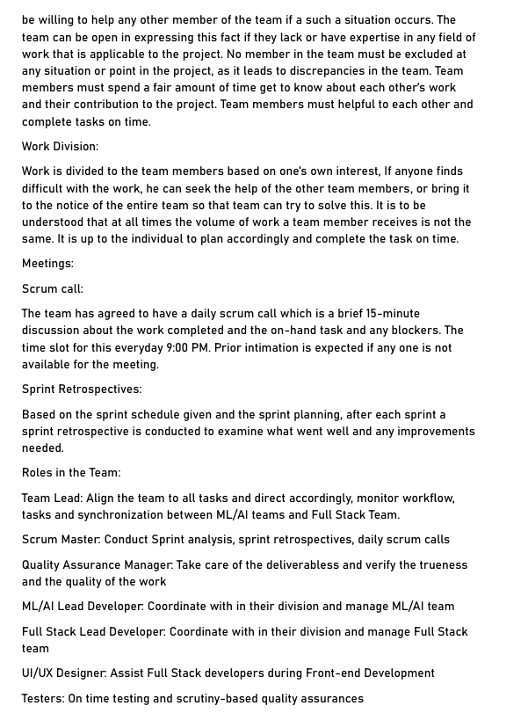
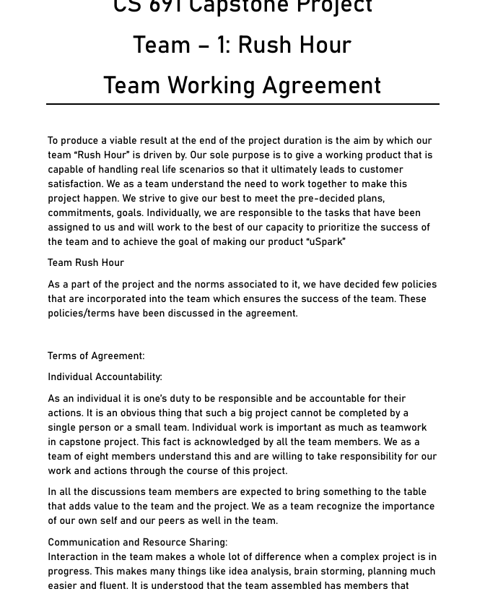
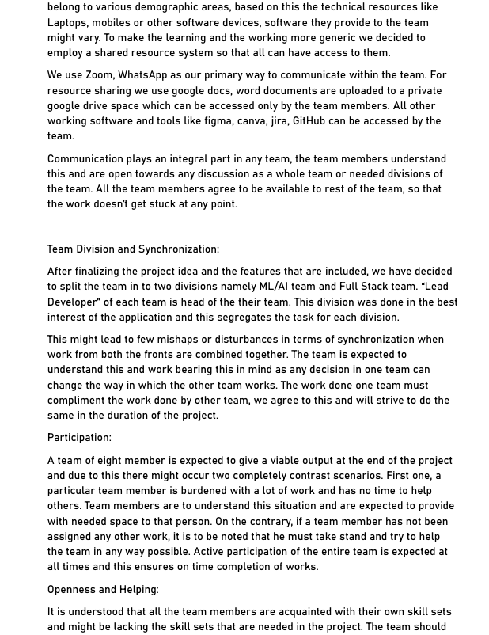
Team Working Agreement
1

Slide 14
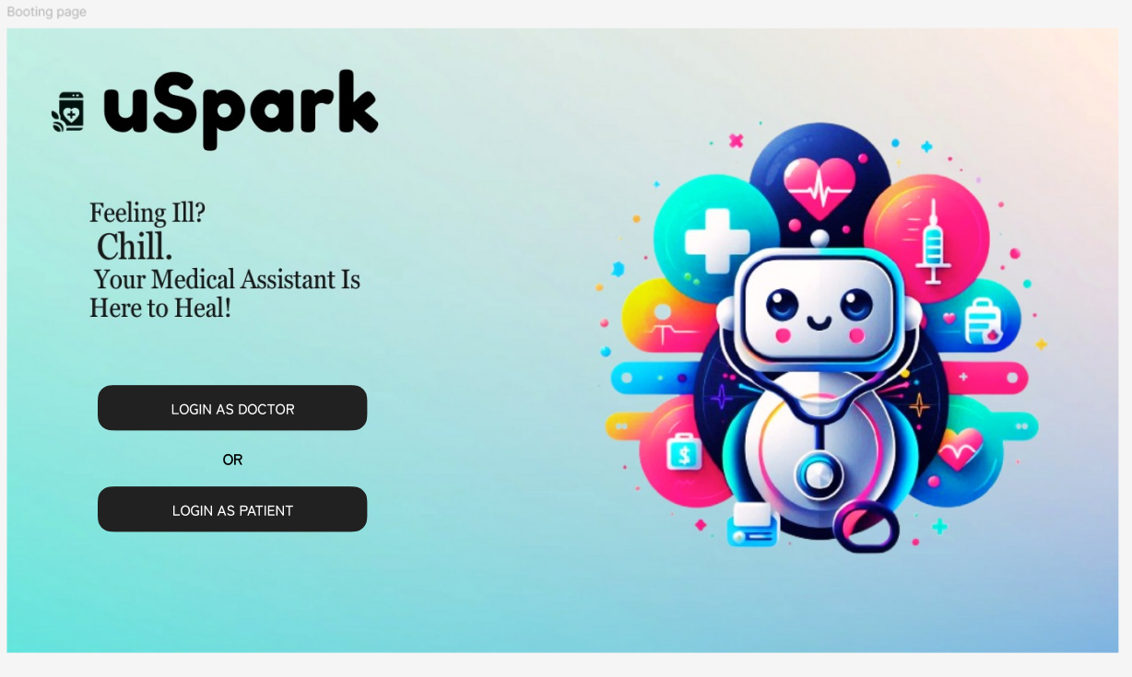
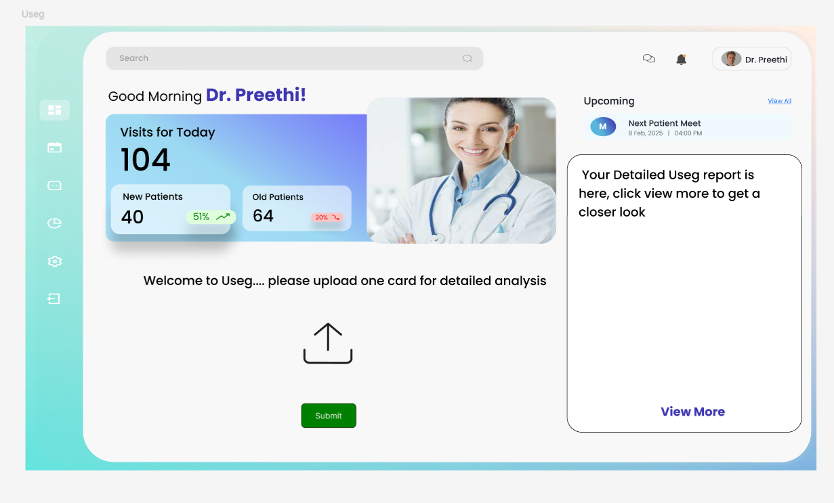
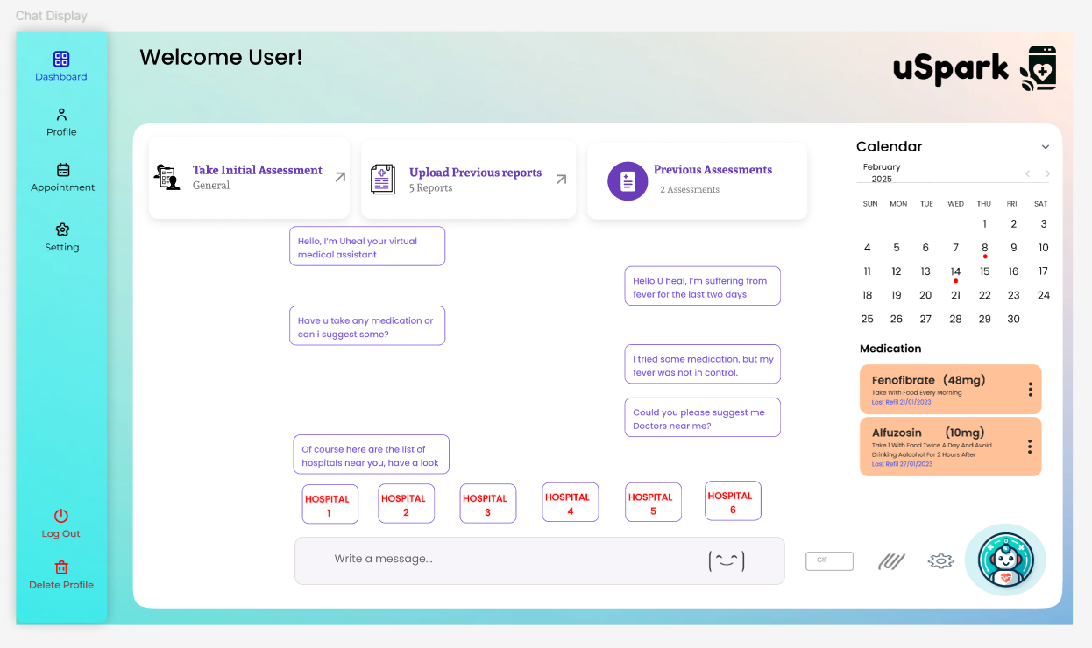
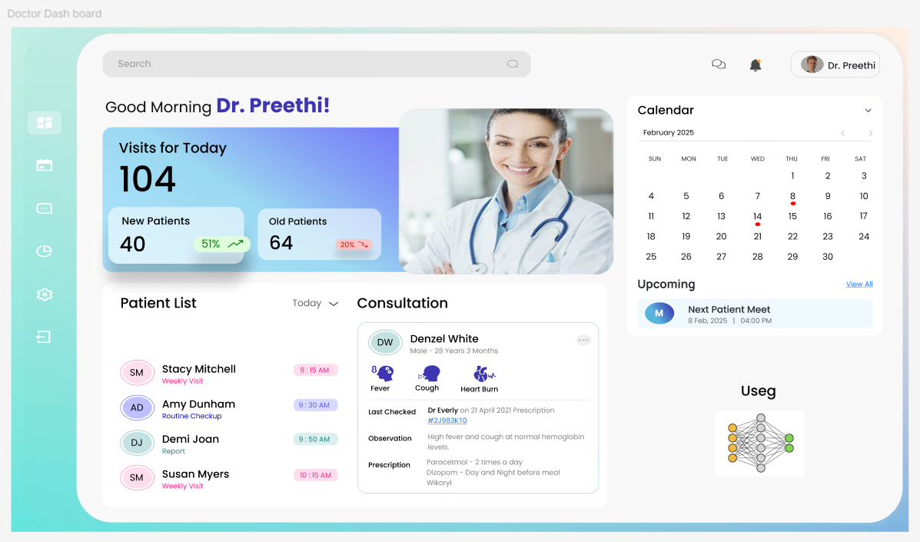
Product Design

Slide 15
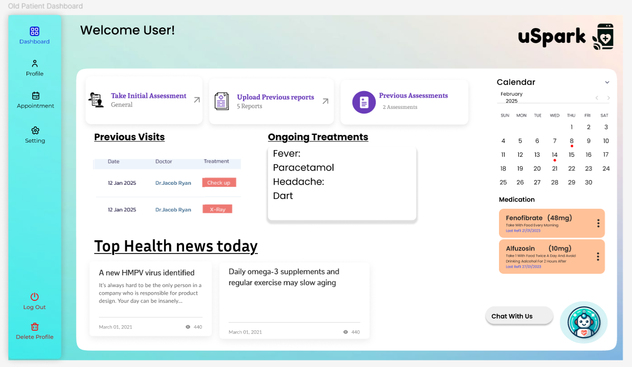
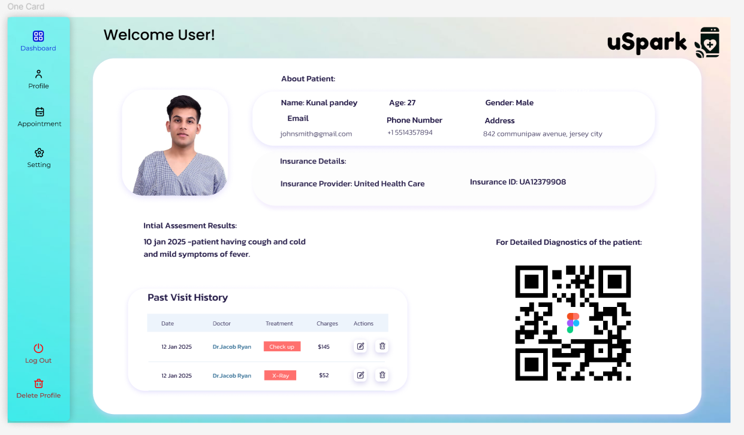
MVP Design

Slide 16
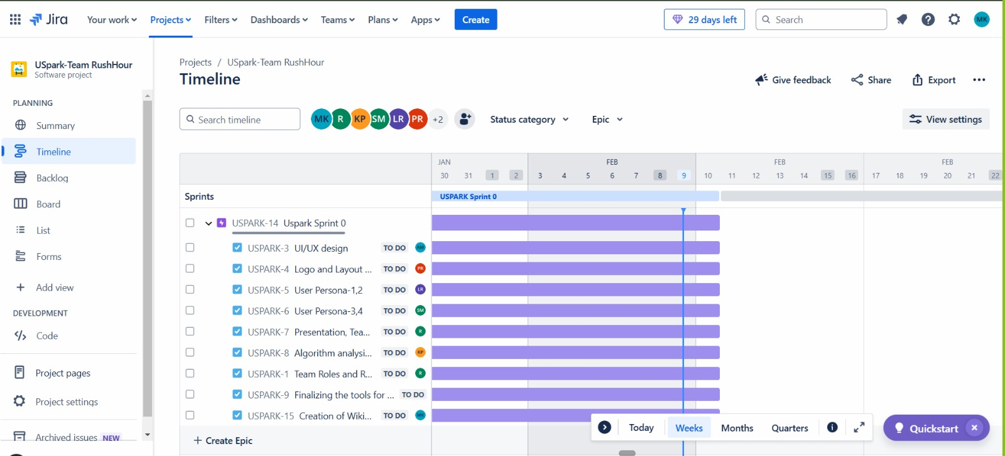
Sprint 0 – Schedule

Slide 17
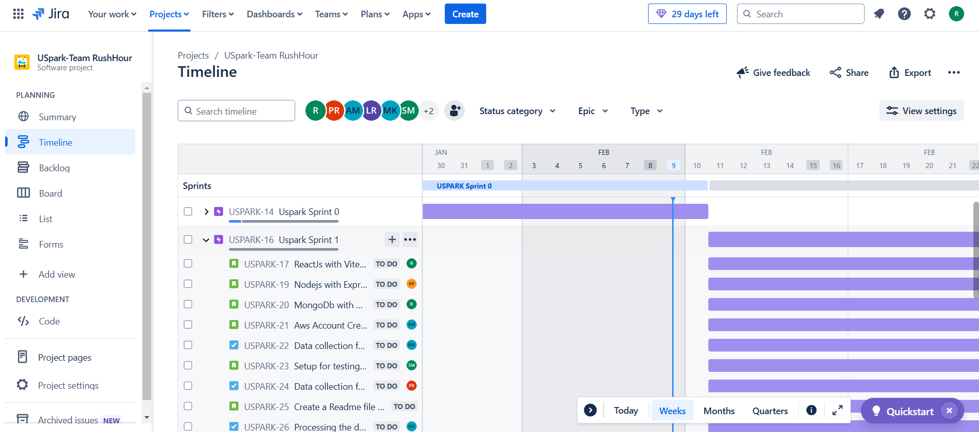
Project Schedule

Slide 18
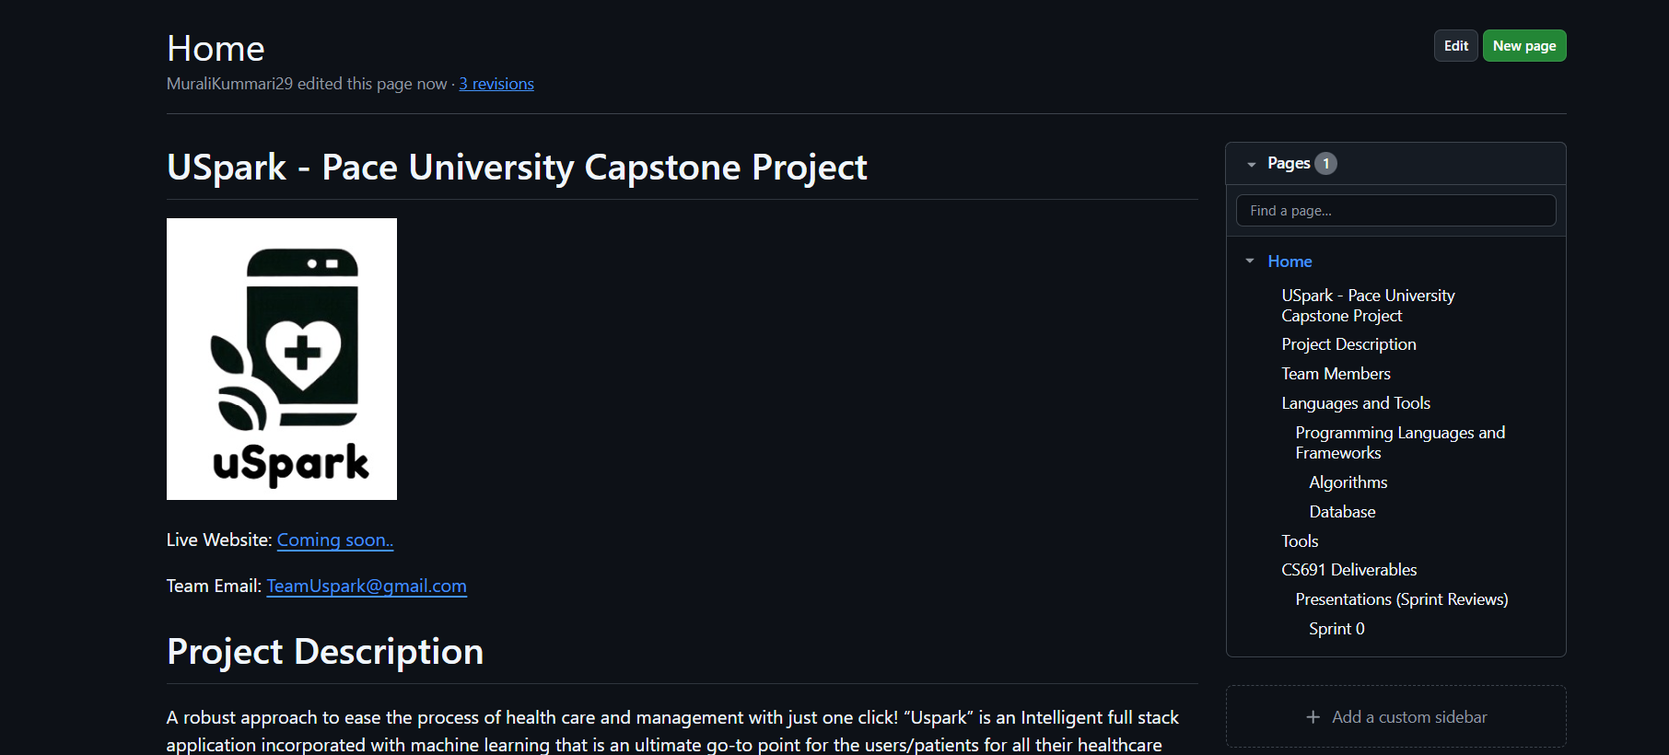
WIKI PAGE
https://github.com/htmw/2025S-RushHour/wiki

Slide 19
THANK YOU
CONTACT US:
teamuspark@gmail.com

